Slide 1
A review on K-means
Chris Kuo, Ph.D.| Columbia University

Slide 2
Procedure
Step 1 - Pick K random points as cluster centers called centroids.
Step 2 - Assign each data point x to the nearest cluster by calculating its distance to each centroid.
Step 3 - Find new cluster center by taking the average of the assigned points.
Step 4 - Repeat Step 2 and 3 until none of the cluster assignments change.

Slide 3
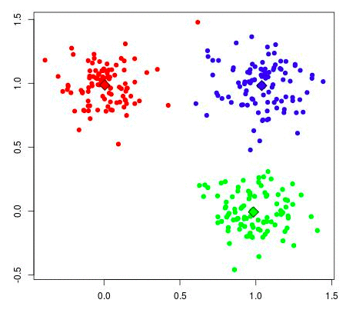
K-Means
Initial random points

Slide 4
K-Means
There are multiple ways to cluster the data but K-Means algorithm is the most used algorithm. Which tries to improve the inter group similarity while keeping the groups as far as possible from each other.
Basically K-Means runs on distance calculations - “Euclidean Distance”
“K” in K-Means represents the number of clusters in which we want our data to divide into.

Slide 5
Business applications
Behavioral segmentation:
Segment by purchase history
Segment by activities on application, website, or platform
Define personas based on interests
Create profiles based on activity monitoring

